Slide 1
Direction Detection of Select Stocks with Machine Learning
Anand Mohan SRN: R19MBA53 | Date: 10/03/2023
MBA in Business Analytics
Capstone Project Presentation
Year: II

Slide 2
Introduction
The stock market is significant financial tool for companies to raise their funds through investments done by the common man.
In return for investors putting their stake in company stocks, they should earn profits through dividends and upward stock movements, which would also enhance their economic status apart from the growth of the participant company whose stocks are at stake in the public domain.
Conventionally, Fundamental analysis is used for evaluating a share's intrinsic value for long-term investment opportunities. Technical analysis evaluate trends, momentum, volume and volatility from a statistical perspective. Algorithmic trading is commonly used approach.
However, the consistency of the prediction performance of most of these techniques remains debatable and the volatility of the market is still unpredictable.
Therefore, investors aim to find better, easy, and simple Machine learning Modelling techniques for forecasting any share’s price to reduce volatility issues most optimally.
Daily Trading NSE Data of HDFC, KOTAK, and SBI Bank from the year 2000 to 2022 is being used for this capstone project.

Slide 3
Literature Review
28 documents were reviewed for the purpose of capstone2.
The effect of Technical and fundamental analysis on investment decisions were researched which included technical analysis for HDFC,KOTAK and SBI stocks. Effects of volatility, trend, momentum indicators for prediction of stock market were researched. Impact of algorithmic trading was studied.
supervised and unsupervised machine learning methods were gone through. Supervised Classification Technique included Decision tree for classification and regression, random forest algorithm, Logistic regression, XGBoost and KNN.
Confusion matrix method of evaluation of error metrics were gone through.
Some of the research gaps observed were that Feature expansion and elimination techniques in data preparation were lacking details, fundamental analysis wasn't explored enough, research on volume indicators in technical analysis was missing. Hyper parameter tuning while discussing machine learning algorithms should have been discussed in more details. Prediction on close price exist but decisions based on directional analysis is missing.

Slide 4

Problem Statement
Plenty of Regression algorithms to detect the closing price of any stock.
Try alternate approaches as well which enables us to decide objectively whether say the price of any stock will move up or move down or remain neutral.
Underfitting and overfitting may destroy the accuracy of our regression models
completely relying only on regression algorithms to quantitatively predict the exact closing price of any stocks is not advisable.
Prediction Accuracy Still Unpredictable. Directional analysis is required.

Slide 5
Project Objectives
1.Explore the data and prepare the data to make it suitable to get utilized in Modelling algorithms.
2.Build the right models by using multiple Classification Modelling techniques .
3. minimize errors in direction prediction.
EDA
Feature Addition.
Get Right Stock.
Collect Relevant data
Logistic Regression
Decision Tree
Random Forest
k-Nearest Neighbours
Extreme Gradient Boosting
Given the historical data, it should be correctly predicted whether the price will move up or move down utilizing precision, recall and accuracy Metrics used in classification modelling techniques.

Slide 6
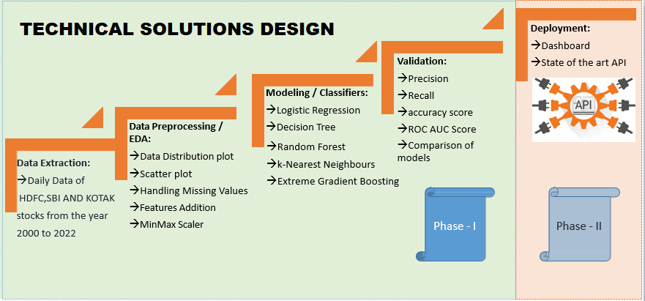
Project Methodology

Slide 7
Business Understanding
Stocks Technical Analysis
Stocks Fundamental Analysis
Technical Indicators | HDFC | KOTAK | SBI
RSI | 58.72 | 60.33 | 69.86
MACD | 18.97 | 25.42 | 14.07
Stochastic | 89.62 | 76.32 | 95.02
ADX | 11.43 | 37.66 | 30.53
ADX Upper Band | 1514.69 | 1970.16 | 582.40
ADX Lower Band | 1261.46 close price of HDFC stock is 1493.05 | 1854.60 close price of KOTAK stock is 1944.20 | 505.09 close price of SBI stock is 575.05
Particulars | HDFC | KOTAK | SBI
Promoters | 25.73% | 25.97% | 57.57%
Investors | 74.27% | 74.03% | 42.43%
Net Profit (Profit and Loss) | 36,961.36 | 8572.69 | 31,675.98
Adjusted EPS | 66.65 | 42.99 | 35.49
Total Liabilities (Balance Sheet) | 20.68, 535.05 | 4,29, 428.40 | 49,87, 597.41
Total Assets (Balance sheet) | 20,68, 535.05 | 4,29, 428.40 | 49,87, 597.41
Closing Cash (cashflow) | 155,386 | 52,665 | 398,905
All figures are in crores for the year 2022.

Slide 8
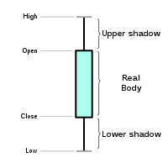
Data Understanding
Symbol | series | Prev Close | Open | High | Low | Last price | Close | VWAP | Vol
HDFC | EQ | 293.5 | 317 | 317 | 297 | 304 | 304.1 | 303.62 | 255251
HDFC | EQ | 304.05 | 290 | 303.9 | 285 | 295 | 292.8 | 294.53 | 269087
KOTAK | EQ | 229.35 | 247.7 | 247.7 | 225 | 247 | 246.9 | 244.12 | 73681
KOTAK | EQ | 246.95 | 229 | 240 | 227 | 228 | 228.4 | 233.75 | 105799
SBI | EQ | 243.65 | 243.6 | 262 | 238 | 258 | 259.1 | 251.46 | 4495 741
SBI | EQ | 259.1 | 249 | 264 | 245 | 249 | 248.5 | 252.35 | 3434 058
The previous close nearly always refers to the previous day's final price.
The last price is the one at which the foremost recent transaction happens.
volume-weighted average worth (VWAP) represents the typical price listed throughout the day,
based on both volume and worth.
Volume and Share turnover is an estimation of stock liquidity.

Slide 9

Data Preparation
Pre-processing | Techniques
Missing Values | Feature Engineering
'Trades', 'Deliverable Volume', and'% Deliverable' had more than 100 missing values. Hence, those columns were dropped. | Newly Added Feature Variables: 13 days,20 days,100 days, 200 days Simple moving averages. exponential moving averages for 7 days,13 days,20 days,100 days, and 200 days. 1 day's previous lag values of volume. 6,10,14 and 30 days consecutive closing prices are tabulated week on week for the entire dataset . Momentum indicators Trend indicators Volatility indicators Volume indicators
MinMax Scaler shrinks the data inside the given range in this project i.e. from zero to one. It scales the price to a selected value range while not varying the form of the initial distribution.

Slide 10
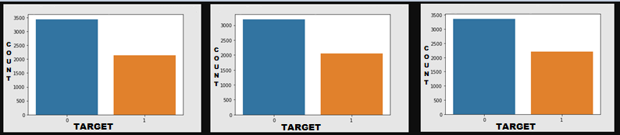
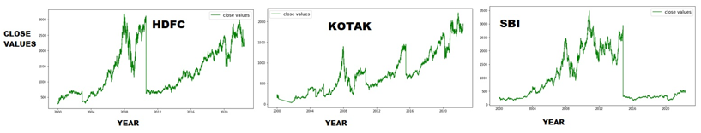
Descriptive Analytics
class distribution For HDFC, KOTAK, and SBI stock
Close values of HDFCBANK, KOTAK BANK, and SBIBANK stock from 2000 to 2022

Slide 11
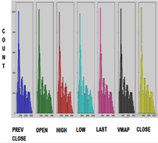
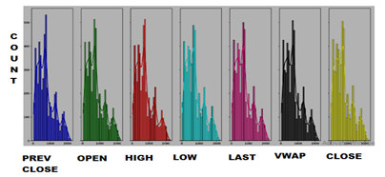
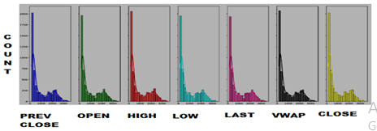
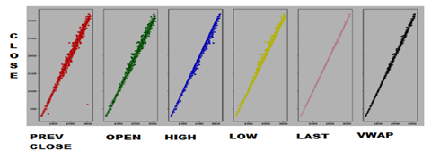
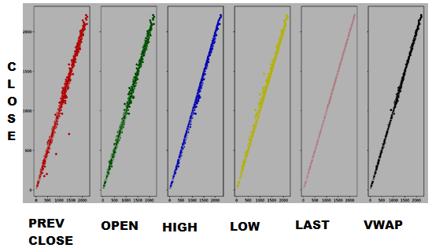
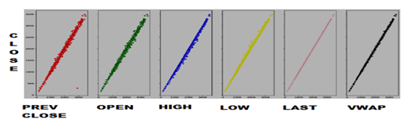
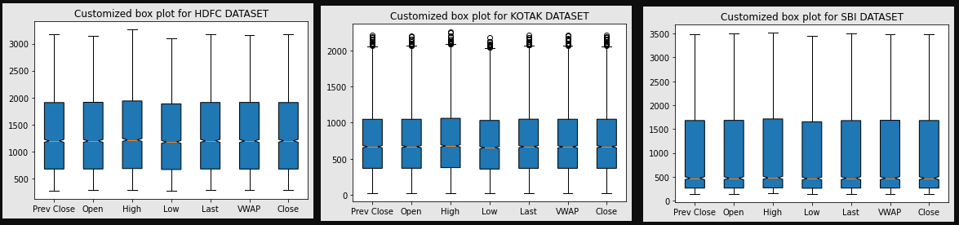
Descriptive Analytics
HDFC
KOTAK
SBI
Data Distribution plot of Feature variables and Close price for HDFC,KOTAK and SBI Stock shows Data has positive skewed distribution.
KOTAK has highest volatility followed by HDFC and then SBI.
Scatter Plot
linear relationship exists between Independent variables and the Target variable except for fewer outliers.
Box plots exhibits large difference between the 75th % tile and max values of most of the feature variables for all 3 stocks. Therefore, it suggests that there are extreme values Outliers in our data set.

Slide 12
Modeling
Modeling Techniques | Modeling Process | Model Building
Modelling Strategies | Model Evaluation Rule
Direction Detection by 6,10,14 days consecutive closing prices split week on the week. | percentage change on closing price>0.7% ➔Positive Trend percentage change on closing price<-0.7% ➔Negative Trend percentage change on closing price between 0.7 and 0.7% ➔Neutral
Go Long Direction Prediction performed separately using Momentum, Trend, Volatility and Volume Indicators | percentage change on closing price>0.5% ➔Positive Trend percentage change on closing price<=0.5% ➔Not Positive Trend
Classification Models used:
Logistic Regression
Decision Tree using Grid SearchCV and Cross Validation
Random Forest using Randomized SearchCV and Cross Validation
K Nearest Neighbours
XG Boost

Slide 13
Model Evaluation
Modelling Strategies | HDFC | KOTAK | SBI
Go Long Direction Prediction using Volume Indicators | precision-0.98 recall-0.83 accuracy-0.92 | precision-0.99 recall-0.93 accuracy-0.97 | precision-0.92 recall-0.80 accuracy-0.90
Go Long Direction Prediction using Momentum Indicators | precision-0.71 recall-0.63 Accuracy-0.76 | precision-0.73 recall-0.61 accuracy-0.75 | precision-0.69 recall-0.62 accuracy-0.74
Go Long Direction Prediction using Trend Indicators | precision-0.83 recall-0.59 Accuracy-0.80 | precision-0.76 recall-0.48 accuracy-0.72 | precision-0.78 recall-0.49 accuracy-0.74
LR
Highest precision, recall and accuracy in Direction Prediction
RF
Highest precision, recall and accuracy in Direction Detection.
Modelling Strategies | HDFC | KOTAK | SBI
Direction Detection by 6,10,14 days consecutive closing prices split week on the week | precision-0.85 recall-0.89 accuracy-0.87 | Precision-0.71 recall-0.79 accuracy-0.74 | Precision-0.83 recall-0.88 accuracy-0.85
Go Long Direction Prediction using Volume Indicators | precision-0.93 recall-0.69 accuracy-0.85 | precision-0.92 recall-0.79 accuracy-0.89 | precision-0.90 recall-0.73 accuracy-0.86
Go Long Direction Prediction using Momentum Indicators | precision-0.76 recall-0.51 Accuracy-0.75 | precision-0.78 recall-0.50 accuracy-0.75 | precision-0.72 recall-0.55 accuracy-0.74
Recall can still be improved.
Modelling Strategies | HDFC | KOTAK | SBI
Go Long Direction Prediction using Volume Indicators | precision-0.90 recall-0.73 accuracy-0.86 | precision-0.92 recall-0.87 accuracy-0.92 | precision-0.88 recall-0.82 accuracy-0.89
Go Long Direction Prediction using Trend Indicators | precision-0.85 recall-0.65 Accuracy-0.82 | precision-0.82 recall-0.61 accuracy-0.79 | precision-0.83 recall-0.67 accuracy-0.81
Go Long Direction Prediction using Volatility Indicators | precision-0.84 recall-0.69 Accuracy-0.82 | precision-0.81 recall-0.63 accuracy-0.79 | precision-0.80 recall-0.67 accuracy-0.81
XG Boost
considerable precision, recall and accuracy in direction prediction

Slide 14
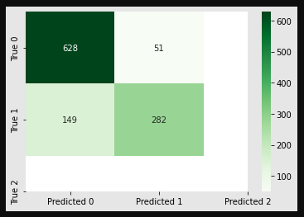
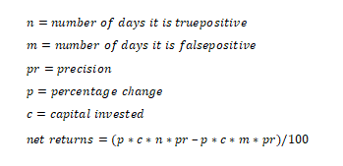
Results and Insights
Go Long Direction Prediction:
Risk-Adjusted Returns:
 | HDFC | KOTAK | SBI
Direction Detection by 6,10,14 days consecutive closing prices split week on the week (RF Classifier ) | precision-0.85 recall-0.89 accuracy-0.87 | Precision-0.71 recall-0.79 accuracy-0.74 | Precision-0.83 recall-0.88 accuracy-0.85
Go Long Direction Prediction using Volume Indicators (LR Classifier ) | precision-0.98 recall-0.83 accuracy-0.92 | precision-0.99 recall-0.93 accuracy-0.97 | precision-0.92 recall-0.80 accuracy-0.90
Go Long Direction Prediction using Momentum Indicators (LR Classifier ) | precision-0.71 recall-0.63 Accuracy-0.76 | precision-0.73 recall-0.61 accuracy-0.75 | precision-0.69 recall-0.62 accuracy-0.74
Go Long Direction Prediction using Trend Indicators (XG Boost Classifier ) | precision-0.85 recall-0.65 Accuracy-0.82 | precision-0.82 recall-0.61 accuracy-0.79 | precision-0.83 recall-0.67 accuracy-0.81
Go Long Direction Prediction using Volatility Indicators (XG Boost Classifier ) | precision-0.84 recall-0.69 Accuracy-0.82 | precision-0.81 recall-0.63 accuracy-0.79 | precision-0.80 recall-0.67 accuracy-0.81
RF…highest precision..Direction Detection.
Calculating Return, Variance, Volatility, Annualized return to Risk ratio and finally, the Sharpe ratios:
LR… best go long direction prediction
HDFC
0.173818
KOTAK
0.149589.
SBI
0.005306.
Invest Rs.10000 for 6 years ,0.5% change on close price
stop loss of 2.0=>reward to risk ratio for approximate 0.8 Precision would be 2*.8/2*.2=4:1
if 0.5% difference in consecutive day close price for any stock is only 2.0.for higher percentage difference than 0.5% reward to risk ratio would be higher.
Net Returns are:
0.5*10000*282*0.85/100-0.5*10000*51*0.85/100
=Rs. 9817.5 profit which would be
9817.5 / (10000*6)*100=16.36% returns.
Utility from the Business perspectives

Slide 15
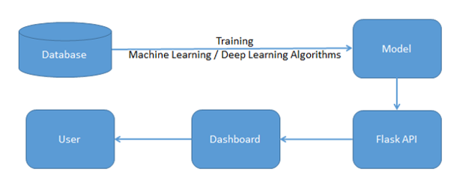
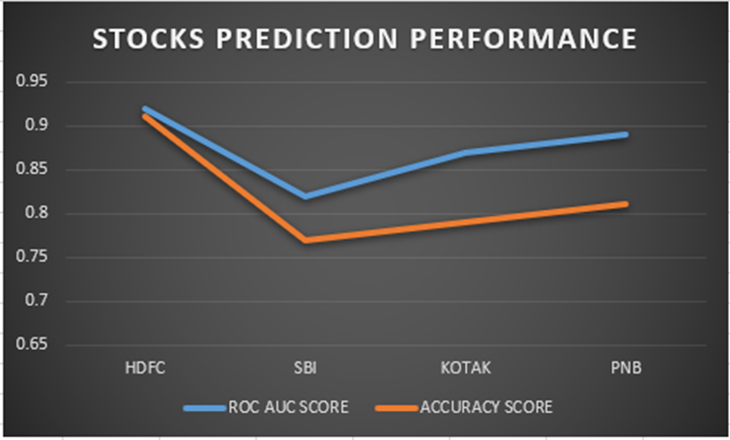
Model Deployment
Demonstration
As per the proposal for future assignments, the dashboard takes API as an input Derived from the machine/deep learning algorithms for multi-label features with an end-to-end User Interface.

Slide 16

Conclusion and Future Work
Proposed solutions | Scope for future work
Any stock on the stock market can utilize the same procedure as defined in this project to forecast buy or sell choices, which is helpful.
Intelligent Automated system on Options Trading would be the next step forward.
In the Future, there is a deployment Dashboard proposed.
In future projects, it can be shown how to define Bullish and Bearish regimes using modern machine learning techniques.
The Sentiment Analysis Approach may also be explored using Text Analytics for predicting stock market returns.

Slide 17
References
Bibliography | Webliography
Al-Bairmani, Z. A. A., & Ismael, A. A. (2021). Using Logistic Regression Model to Study the Most Important Factors Which Affects Diabetes for the Elderly in the City of Hilla / 2019. Journal of Physics: Conference Series, 1818(1). https://doi.org/10.1088/1742-6596/1818/1/012016
Alhomadi, A. (2021). Forecasting stock market prices : A machine learning approach. Digital Commons, 11(2), 16–36.
Anjani, T., & Syarif, A. D. (2019). The Effect of Fundamental Analysis on Stock Returns using Data Panels ; Evidence Pharmaceutical Companies listed on IDX. International Journal of Innovate Science and Research Technology, 4(7), 500–505.
Cornellius Yudha Wijaya. (2021). CRISP-DM Methodology For Your First Data Science Project. https://towardsdatascience.com/crisp-dm-methodology-for-your-first-data-science-project-769f35e0346c
Dahham, A. Z. D., & Ibrahim, A. A. (2020). Effects of Volatility and Trend Indicator for Improving Price Prediction of Cryptocurrency. IOP Conference Series: Materials Science and Engineering, 928(3). https://doi.org/10.1088/1757-899X/928/3/032043
Dar, A. N. (2021). PRINCIPAL COMPONENT ANALYSIS (PCA) (Using Eigen Decomposition). Gsj, 9(7), 240–252. www.globalscientificjournal.com
Elbialy, B. A. (2019). The Effect of Using Technical and Fundamental Analysis on the Effectiveness of Investment Decisions of Traders on the Egyptian Stock Exchange. International Journal of Applied Engineering Research, 14(24), 4492–4501. http://www.ripublication.com
Faijareon, C., & Sornil, O. (2019). Evolving and combining technical indicators to generate trading strategies. Journal of Physics: Conference Series, 1195(1). https://doi.org/10.1088/1742-6596/1195/1/012010
Hafeez, M. A., Rashid, M., Tariq, H., Abideen, Z. U., Alotaibi, S. S., & Sinky, M. H. (2021). Performance improvement of decision tree: A robust classifier using tabu search algorithm. Applied Sciences (Switzerland), 11(15). https://doi.org/10.3390/app11156728
Hansen, K. B. (2020). The virtue of simplicity: On machine learning models in algorithmic trading. Big Data and Society, 7(1). https://doi.org/10.1177/2053951720926558
Huang, Y., Capretz, L. F., & Ho, D. (2021). Machine Learning for Stock Prediction Based on Fundamental Analysis. 2021 IEEE Symposium Series on Computational Intelligence, SSCI
2021 - Proceedings. https://doi.org/10.1109/SSCI50451.2021.9660134
Jena, M., & Dehuri, S. (2020). Decision tree for classification and regression: A state-of-the art review. Informatica (Slovenia), 44(4), 405–420. https://doi.org/10.31449/INF.V44I4.3023
Kimbonguila, A., Matos, L., Petit, J., Scher, J., & Nzikou, J.-M. (2019). Effect of Physical Treatment on the Physicochemical, Rheological and Functional Properties of Yam Meal of the Cultivar “Ngumvu” From Dioscorea Alata L. of Congo. International Journal of Recent Scientific Research, 10, 30693–30695. https://doi.org/10.24327/IJRSR
Magner, N., Lavin, J. F., Valle, M., & Hardy, N. (2021). The predictive power of stock market’s expectations volatility: A financial synchronization phenomenon. PLoS ONE, 16(5 May), 1–21. https://doi.org/10.1371/journal.pone.0250846
Markoulidakis, I., Kopsiaftis, G., Rallis, I., & Georgoulas, I. (2021). Multi-Class Confusion Matrix Reduction method and its application on Net Promoter Score classification problem. ACM International Conference Proceeding Series, 412–419. https://doi.org/10.1145/3453892.3461323
Mohapatra, S., & Misra, A. K. (2020). Momentum returns: A portfolio-based empirical study to establish evidence, factors and profitability in Indian stock market. IIMB Management Review, 32(1), 75–84. https://doi.org/10.1016/j.iimb.2019.07.007
moneycontrol. (n.d.). HDFC Bank Ltd.TECHNICALS. https://www.moneycontrol.com/technical-analysis/hdfcbank/HDF01/weekly
Mukerji, P., Chung, C., Walsh, T., & Xiong, B. (2019). The Impact of Algorithmic Trading in a Simulated Asset Market. Journal of Risk and Financial Management, 12(2), 68. https://doi.org/10.3390/jrfm12020068
Omta, W. A., van Heesbeen, R. G., Shen, I., de Nobel, J., Robers, D., van der Velden, L. M., Medema, R. H., Siebes, A. P. J. M., Feelders, A. J., Brinkkemper, S., Klumperman, J. S., Spruit, M. R., Brinkhuis, M. J. S., & Egan, D. A. (2020). Combining Supervised and Unsupervised Machine Learning Methods for Phenotypic Functional Genomics Screening. SLAS Discovery, 25(6), 655–664. https://doi.org/10.1177/2472555220919345
Rajkar, A., Kumaria, A., Raut, A., & Kulkarni, N. (2021). Stock Market Price Prediction and Analysis. International Journal of Engineering Research & Technology, 10(06), 115–119.
Rouf, N., Malik, M. B., Arif, T., Sharma, S., Singh, S., Aich, S., & Kim, H. C. (2021). Stock
market prediction using machine learning techniques: A decade survey on methodologies, recent developments, and future directions. Electronics (Switzerland), 10(21). https://doi.org/10.3390/electronics10212717
Schonlau, M., & Zou, R. Y. (2020). The random forest algorithm for statistical learning. Stata Journal, 20(1), 3–29. https://doi.org/10.1177/1536867X20909688
Shah, D., Isah, H., & Zulkernine, F. (2019). Stock market analysis: A review and taxonomy of prediction techniques. International Journal of Financial Studies, 7(2). https://doi.org/10.3390/ijfs7020026
Silva, I., & Naranjo, J. E. (2020). A systematic methodology to evaluate prediction models for driving style classification. Sensors (Switzerland), 20(6), 1–21. https://doi.org/10.3390/s20061692
Sonkiya, P., Bajpai, V., & Bansal, A. (2021). Stock price prediction using BERT and GAN. http://arxiv.org/abs/2107.09055
Thanekar, G. S., & Shaikh, Z. S. (2021). Analysis and Evaluation of Technical Indicators for Prediction of Stock Market. International Journal of Engineering Research & Technology (IJERT), 10(May), 341–344.
Wang, L. (2019). Research and Implementation of Machine Learning Classifier Based on KNN. IOP Conference Series: Materials Science and Engineering, 677(5), 0–5. https://doi.org/10.1088/1757-899X/677/5/052038
Zhang, P., Jia, Y., & Shang, Y. (2022). Research and application of XGBoost in imbalanced data. International Journal of Distributed Sensor Networks, 18(6). https://doi.org/10.1177/15501329221106935

Slide 18
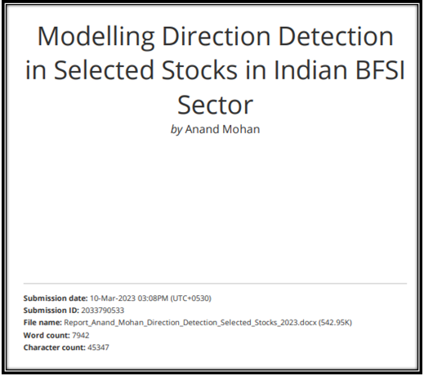
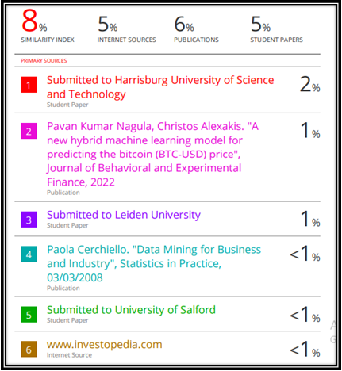
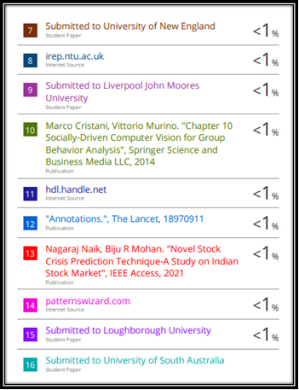
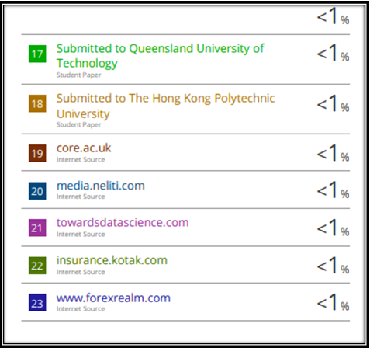
Plagiarism Report

Slide 19
Annexure
Publications | Conferences
The implementation for the capstone project can be accessed at the link below:
https://github.com/Embedded-org/ACCOMPLISHMENTS/tree/master/RACE_CAPSTONE_PROJECT2

Slide 20
Thank You!

